Slide 1
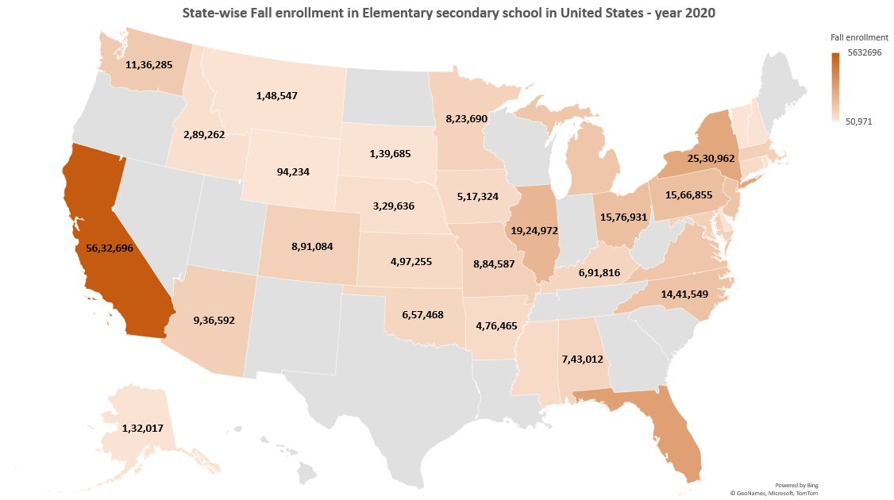
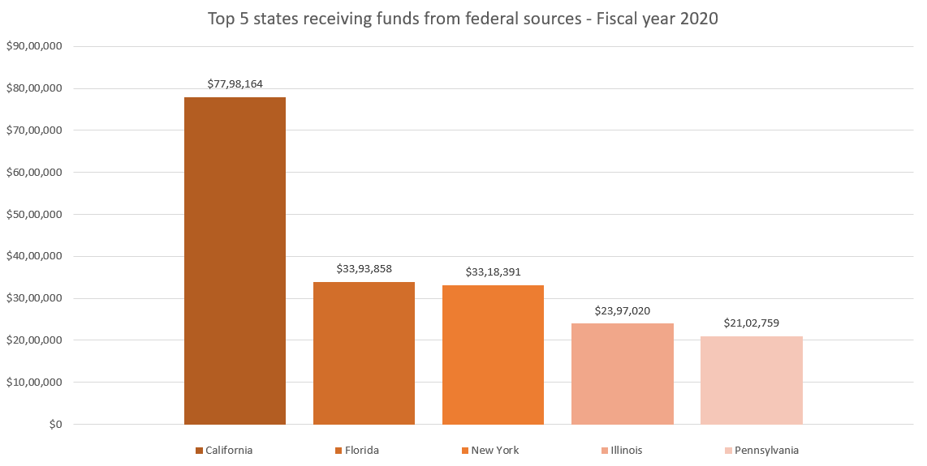
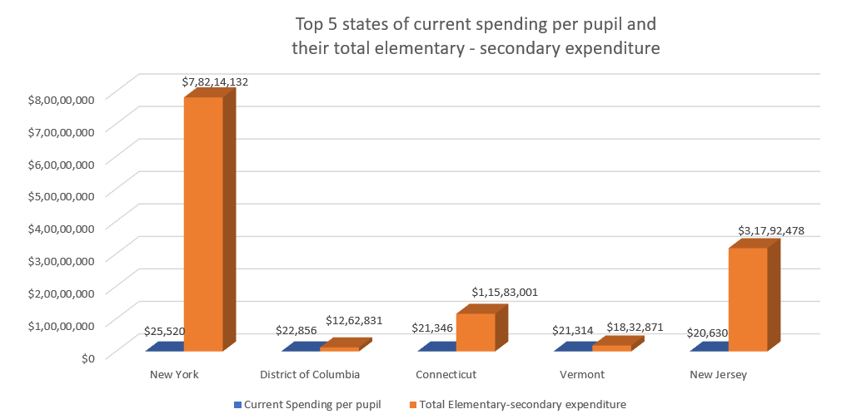





Data Visualization Source: U.S Census Bureau 2020
Data Visualization: Elementary Secondary School Finances - year 2020
Data Visualization Source: U.S Census Bureau 2020
Data Visualization Source: U.S Census Bureau 2020

